Slide 1
Topic Modeling via Latent Dirichlet Allocation
Pattern Recognition, 2023

Slide 2
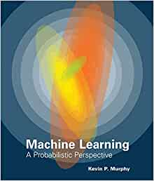
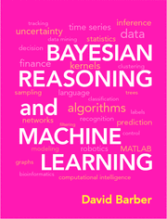

Main References
Machine Learning: A Probabilistic Perspective, Kevin P. Murphy, 2012
Bayesian Reasoning and Machine Learning (BRML), David Barber, 2020
《统计学习方法(第2版)》, 李航, 2019
Parameter estimation for text analysis, Technical Note by Gregor Heinrich
10-701 (Introduction to Machine Learning) and 10-708 (Probabilistic Graphical Models) in CMU, by Prof. Eric P. Xing
CPSC 440 (Advanced Machine Learning) in University of British Columbia, by Prof. Mark Schmidt

Slide 3

Motivation
Suppose you’re given a massive number of documents and asked to do
Organize the documents into thematic categories
Describe the evolution of those categories over time
Enable a domain expert to analyze and understand the content
Find relationships between the categories
…
Humans cannot afford to deal with a huge number of text documents. We need algorithms to deal with them…

Slide 4
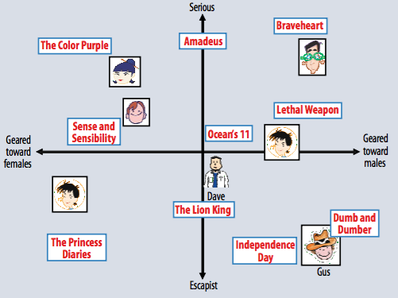
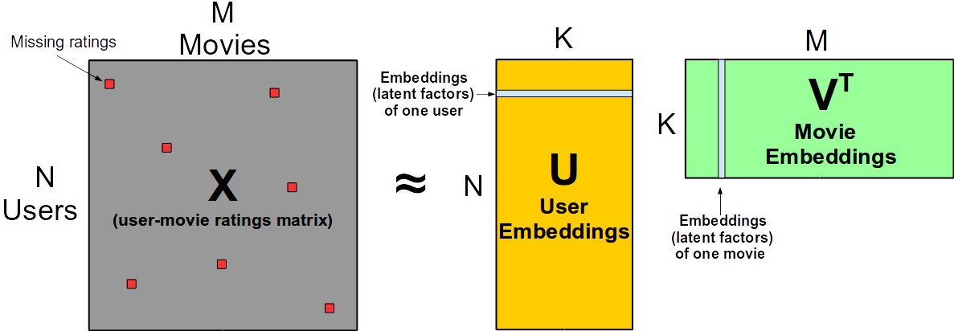
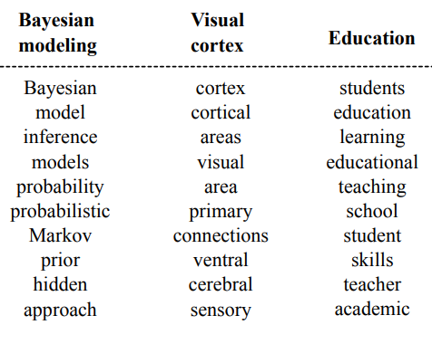
Topic Modeling
Remind in collaborative filtering, matrix completion (factorization) yields latent factors for movies/songs.
Similarly, we want a model of the latent factors making up a set of documents.
The topics of a document serve the purpose.
Topics are what the article (document) mainly talks about.
Topics are reflected by the words (e.g., terminologies) used.

Slide 5
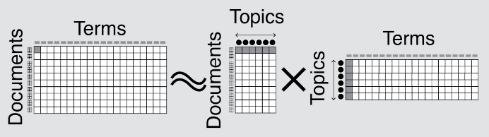


Topic Modeling
Analogous to collaborative filtering, we expect a latent factor model by matrix factorization:
Represented as a graphical model (useful to make things probabilistic):
Q: what elements should we fill in for the “document-term” matrix?
Terms
Terms
Documents
Documents
Topics
To sum over

Slide 6
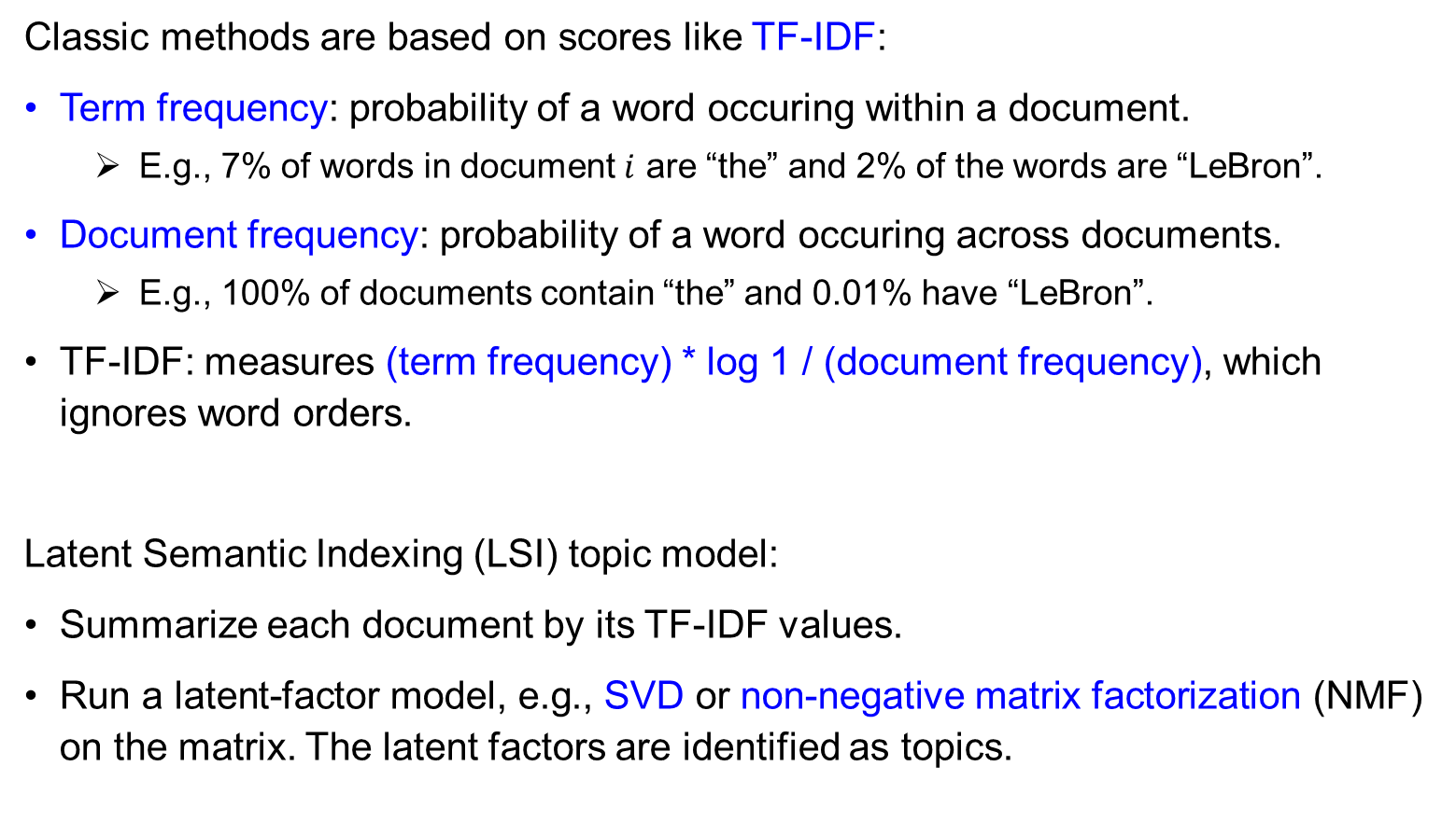
Classic Approach: Latent Semantic Indexing
Classic methods are based on scores like TF-IDF:
Term frequency: probability of a word occuring within a document.
E.g., 7% of words in document $i$ are “the” and 2% of the words are “LeBron”.
Document frequency: probability of a word occuring across documents.
E.g., 100% of documents contain “the” and 0.01% have “LeBron”.
TF-IDF: measures (term frequency) * log 1 / (document frequency), which ignores word orders.
Latent Semantic Indexing (LSI) topic model:
Summarize each document by its TF-IDF values.
Run a latent-factor model, e.g., SVD or non-negative matrix factorization (NMF) on the matrix. The latent factors are identified as topics.

Slide 7
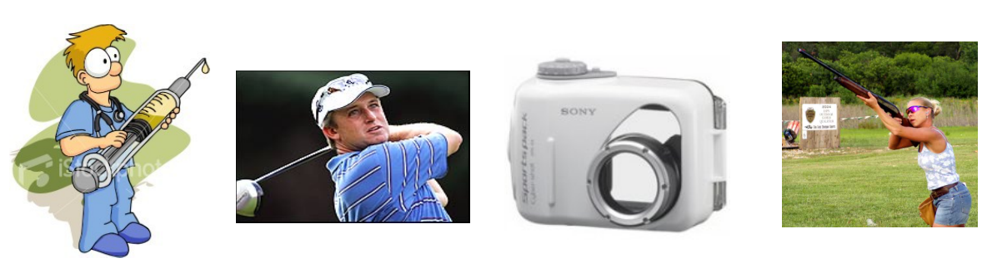
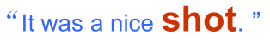
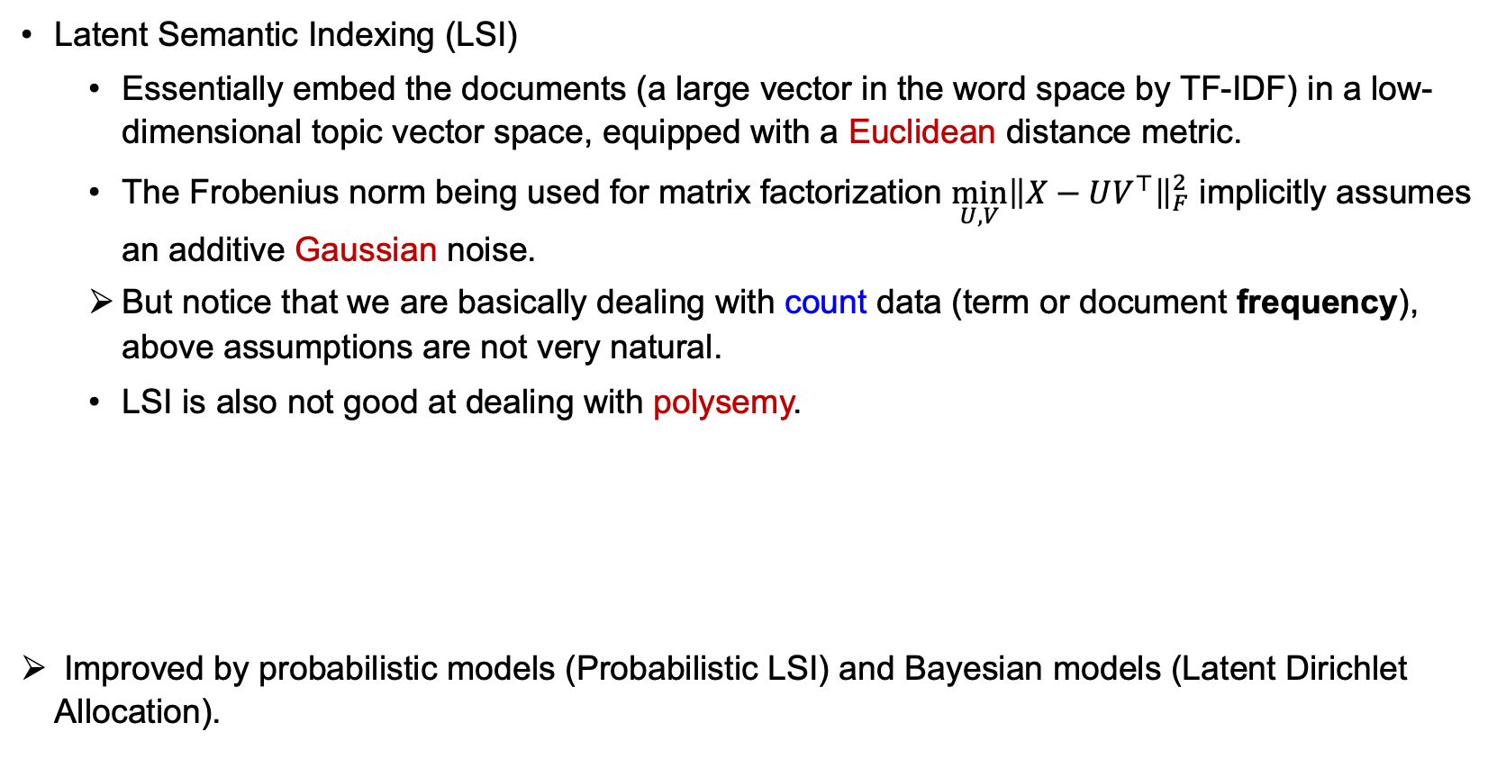
Classic Approach: Latent Semantic Indexing
Latent Semantic Indexing (LSI)
Essentially embed the documents (a large vector in the word space by TF-IDF) in a low-dimensional topic vector space, equipped with a Euclidean distance metric.
The Frobenius norm being used for matrix factorization ${\min_{U,V}\left\|X−UV^{⊤}\right\|}_{F}^{2}$ implicitly assumes an additive Gaussian noise.
But notice that we are basically dealing with count data (term or document frequency), above assumptions are not very natural.
LSI is also not good at dealing with polysemy.
Improved by probabilistic models (Probabilistic LSI) and Bayesian models (Latent Dirichlet Allocation).
Notes:
Q: what distribution will be more suitable rather than Gaussian?
Polysemy: the term in the latent topic space has a low weight in each topic, therefore not representative of the topic.

Slide 8
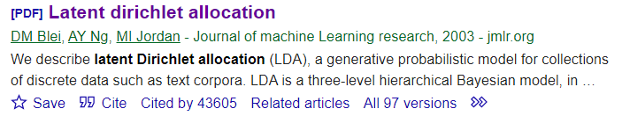
Modern Approach: Latent Dirichlet Allocation
LSI has largely been replace by latent Dirichlet allocation (LDA).
Superior performance.
Many extensions and applications.
Latent Dirichlet Allocation
Still ignores word order.
Tries to explain all words in terms of topics.
Hierarchical Bayesian model of all words in a document.
LDA has several components, we’ll build up to it by parts.

Slide 9
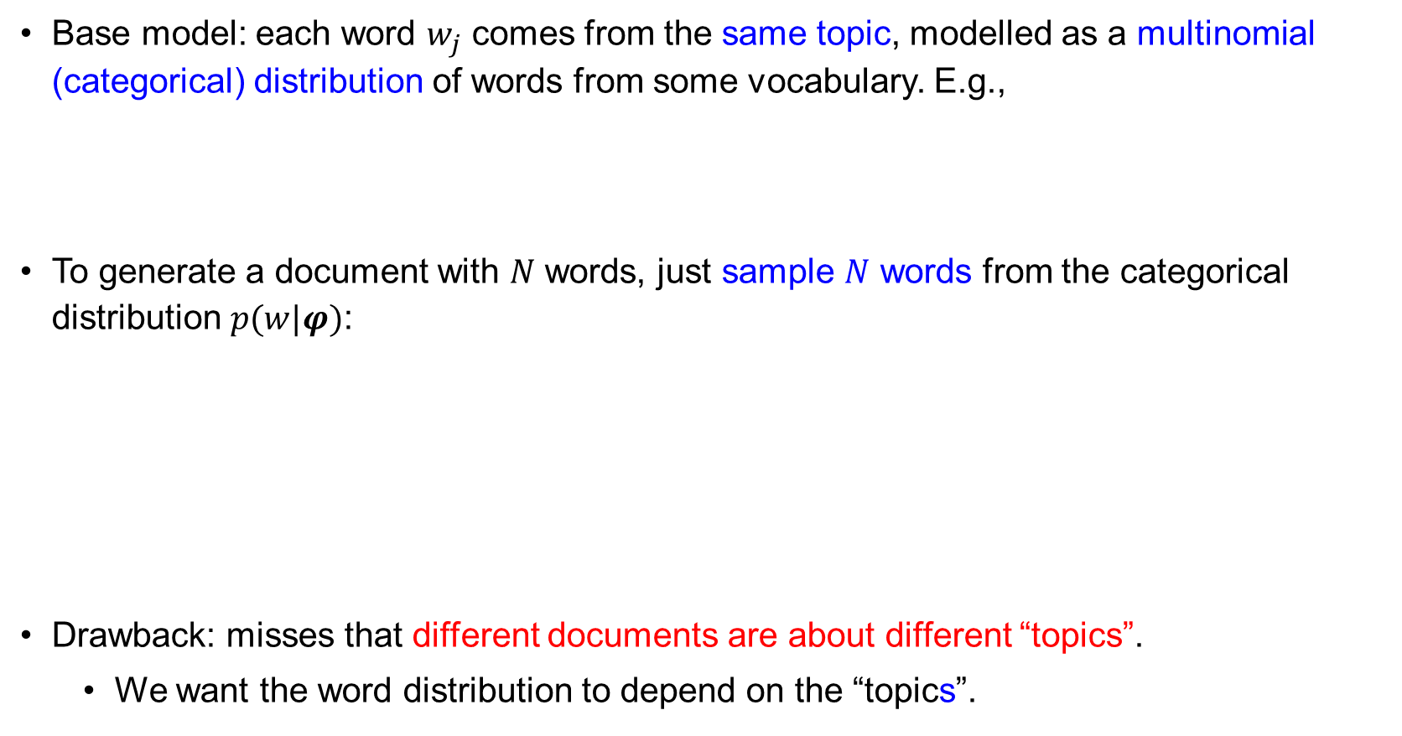
Model 1: Multinomial Distribution of Words
Base model: each word $w_{j}$ comes from the same topic, modelled as a multinomial (categorical) distribution of words from some vocabulary. E.g.,
To generate a document with $N$ words, just sample $N$ words from the categorical distribution $p(w|φ)$:
Drawback: misses that different documents are about different “topics”.
We want the word distribution to depend on the “topics”.
Assumption: word order does not matter (or exchangeable) when concerning topic.
(e.g., the writer may mention the term “hoop” in any part of the text).

Slide 10


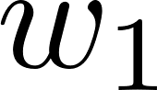
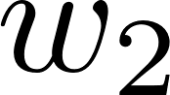
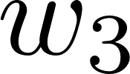
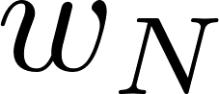
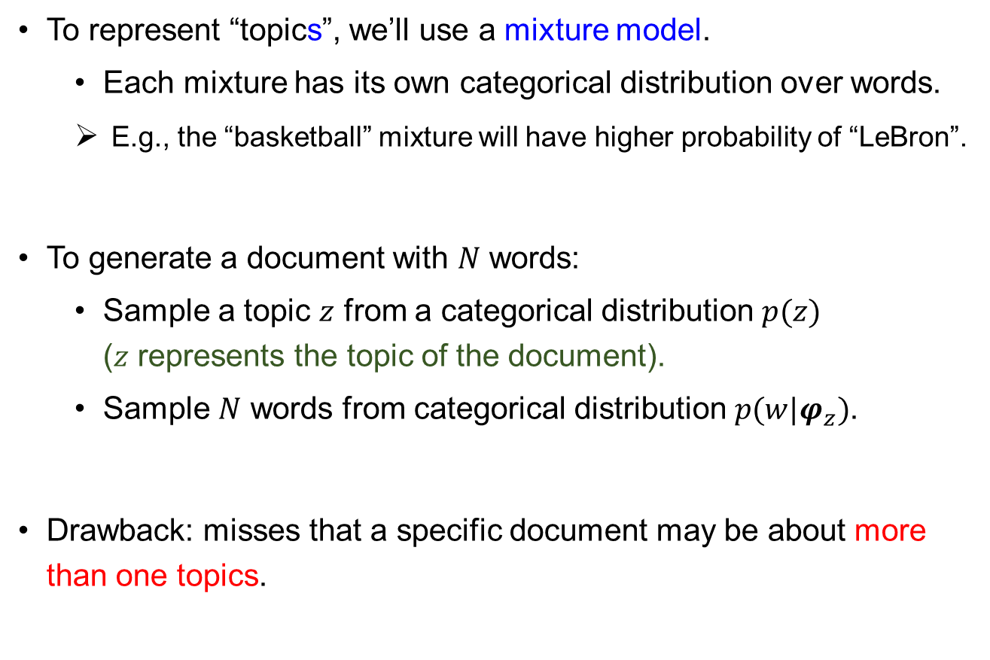
Model 2: Mixture of Multinomial
To represent “topics”, we’ll use a mixture model.
Each mixture has its own categorical distribution over words.
E.g., the “basketball” mixture will have higher probability of “LeBron”.
To generate a document with $N$ words:
Sample a topic $z$ from a categorical distribution $p(z)$ ($z$ represents the topic of the document).
Sample $N$ words from categorical distribution $p(w|φ_{z})$.
Drawback: misses that a specific document may be about more than one topics.

Slide 11

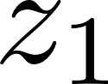
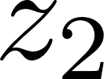
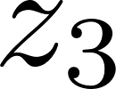
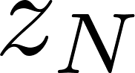
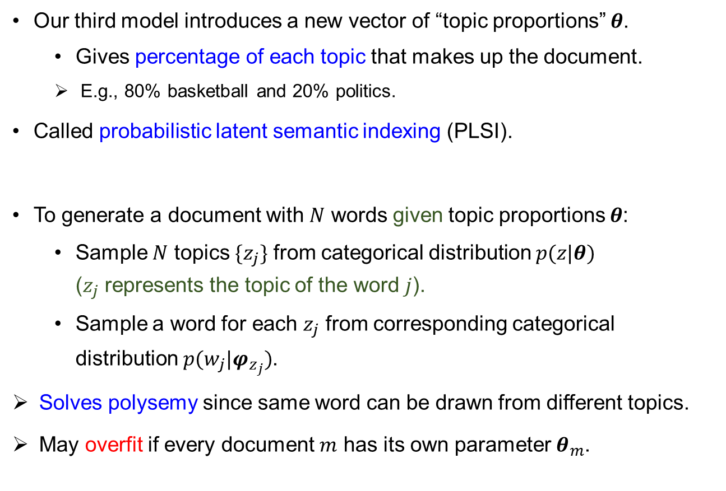
Model 3: Multi-Topic Mixture of Multinomial
Our third model introduces a new vector of “topic proportions” $θ$.
Gives percentage of each topic that makes up the document.
E.g., 80% basketball and 20% politics.
Called probabilistic latent semantic indexing (PLSI).
To generate a document with $N$ words given topic proportions $θ$:
Sample $N$ topics $\{z_{j}\}$ from categorical distribution $p(z|θ)$ ($z_{j}$ represents the topic of the word $j$).
Sample a word for each $z_{j}$ from corresponding categorical distribution $p(w_{j}|φ_{z_{j}})$.
Solves polysemy since same word can be drawn from different topics.
May overfit if every document $m$ has its own parameter $θ_{m}$.

Slide 12
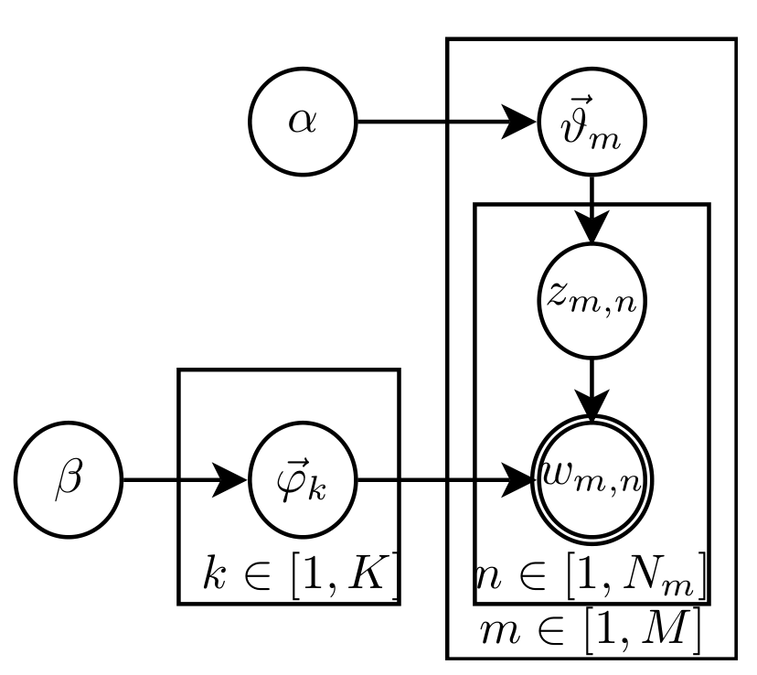
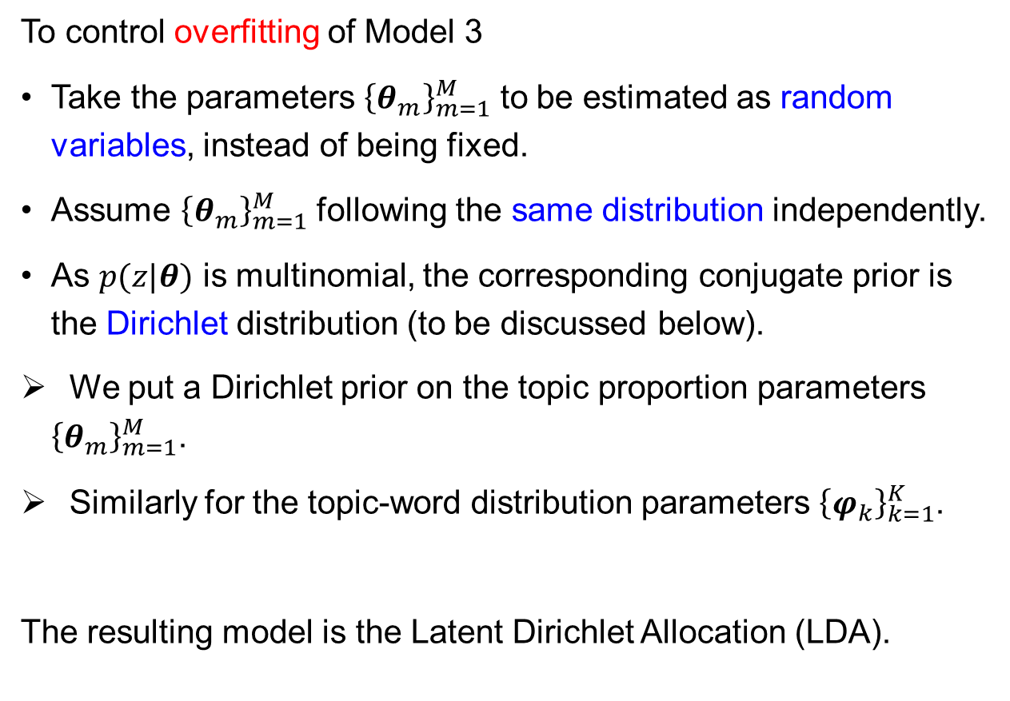
Model 4: Latent Dirichlet Allocation
To control overfitting of Model 3
Take the parameters ${\left\{θ_{m}\right\}}_{m=1}^{M}$ to be estimated as random variables, instead of being fixed.
Assume ${\left\{θ_{m}\right\}}_{m=1}^{M}$ following the same distribution independently.
As $p(z|θ)$ is multinomial, the corresponding conjugate prior is the Dirichlet distribution (to be discussed below).
We put a Dirichlet prior on the topic proportion parameters ${\left\{θ_{m}\right\}}_{m=1}^{M}$.
Similarly for the topic-word distribution parameters ${\left\{φ_{k}\right\}}_{k=1}^{K}$.
The resulting model is the Latent Dirichlet Allocation (LDA).
Plate notation of LDA
Notes:
Plate notation: assume i.i.d. inside the box.
Remark: Eventually, we may still want to infer the realizations of $\{θ_{m},φ_{k}\}$ consistent with a given corpus, which are a lot of parameters.
But they are constrained by the prior, so cannot be varied very freely (effective # of D.O.F is smaller).

Slide 13
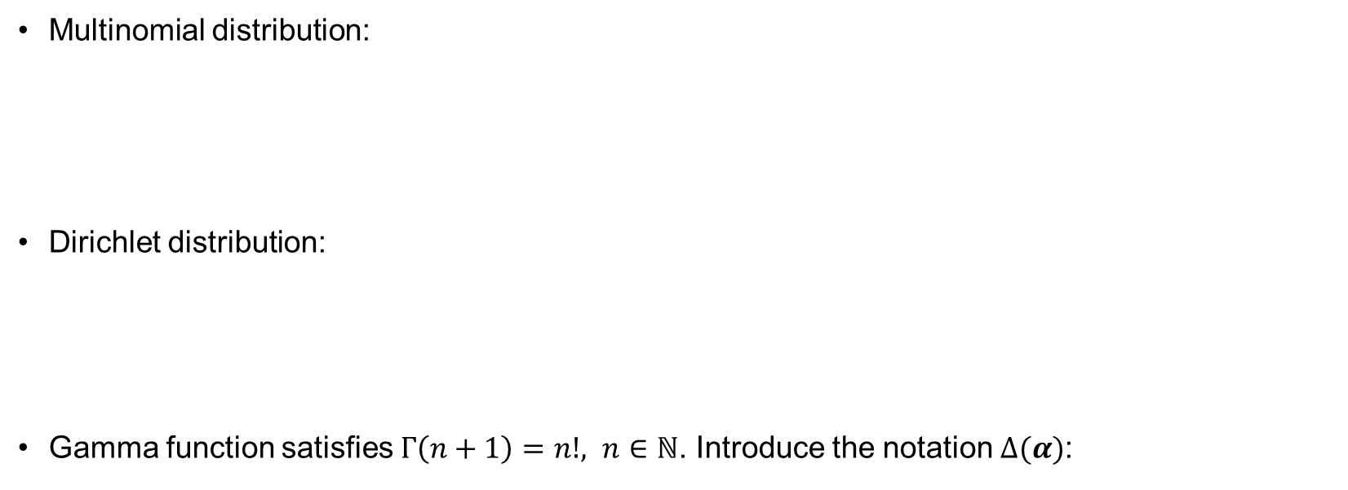
Multinomial and Dirichlet Distributions
Multinomial distribution:
Dirichlet distribution:
Gamma function satisfies $Γ\left(n+1\right)=n!, n∈ℕ$. Introduce the notation $Δ(α)$:
(From normalization of Dirichlet)

Slide 14
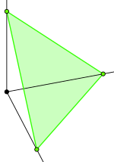
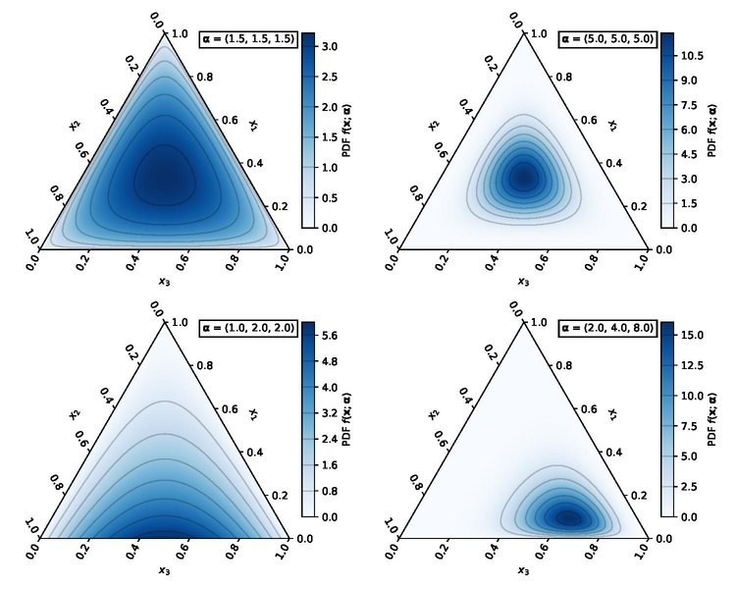
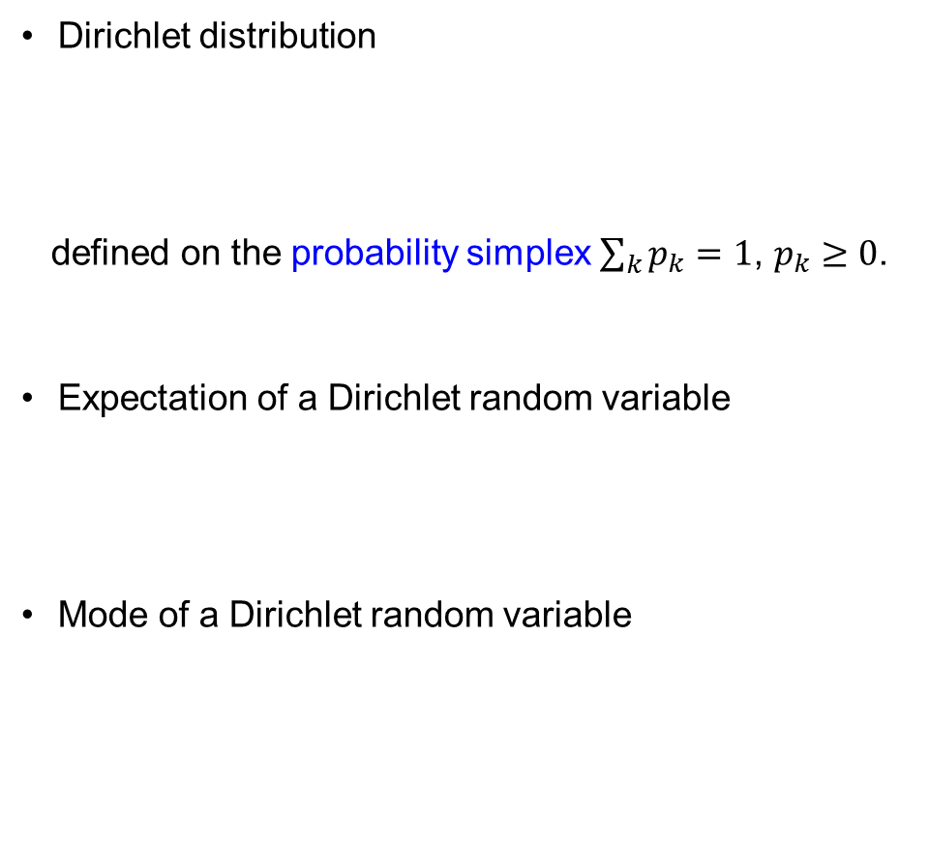
Dirichlet Distribution
Dirichlet distribution
defined on the probability simplex $\sum_{k}{p_{k}}=1$, $p_{k}≥0$.
Expectation of a Dirichlet random variable
Mode of a Dirichlet random variable

Slide 15
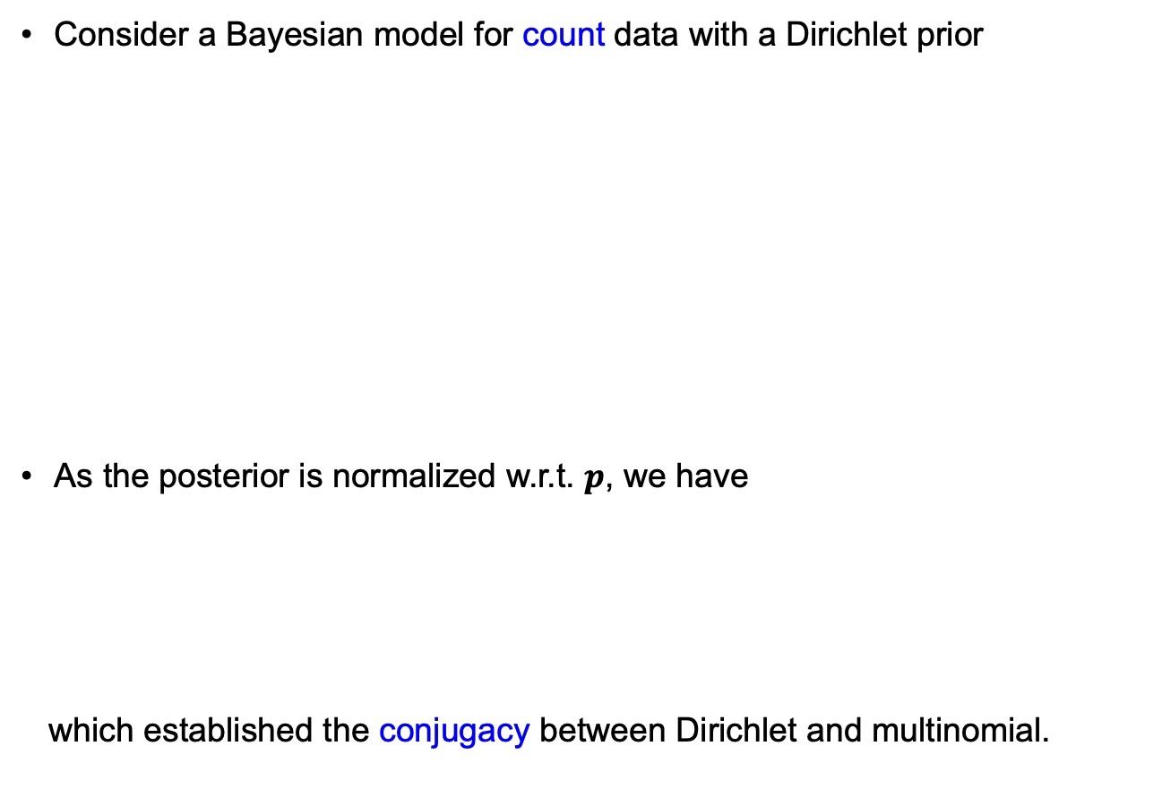
Dirichlet-Multinomial Conjugacy
Consider a Bayesian model for count data with a Dirichlet prior
As the posterior is normalized w.r.t. $p$, we have
which established the conjugacy between Dirichlet and multinomial.

Slide 16

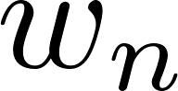
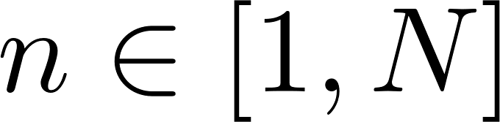
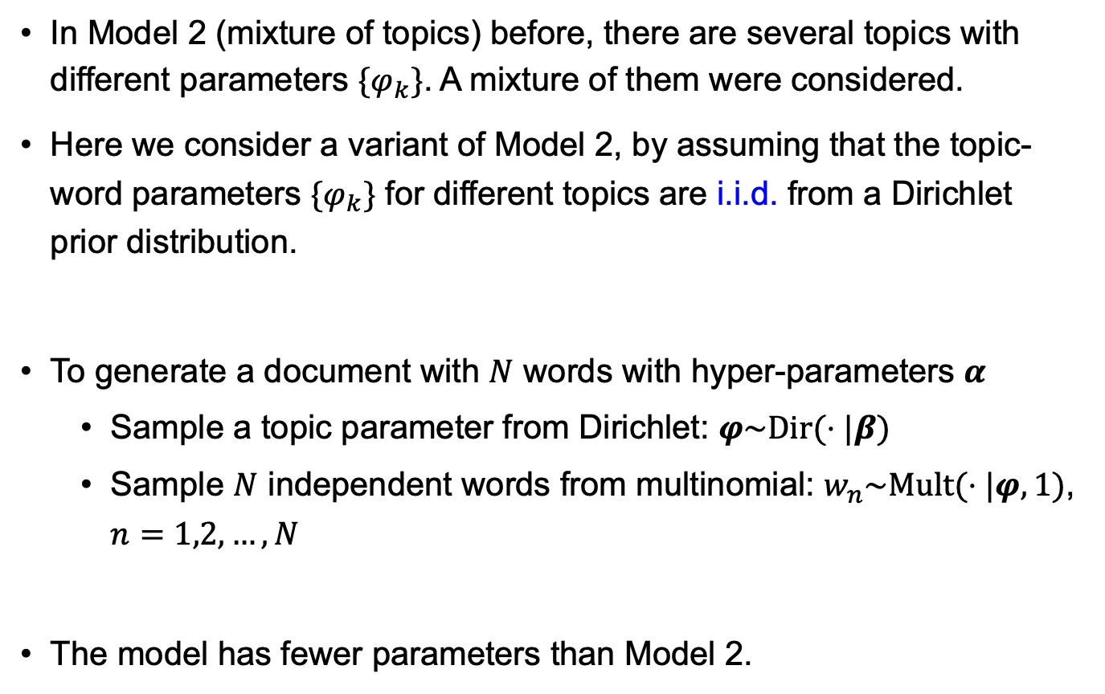
Dirichlet-Multinomial Model for Texts
In Model 2 (mixture of topics) before, there are several topics with different parameters $\{φ_{k}\}$. A mixture of them were considered.
Here we consider a variant of Model 2, by assuming that the topic-word parameters $\{φ_{k}\}$ for different topics are i.i.d. from a Dirichlet prior distribution.
To generate a document with $N$ words with hyper-parameters $α$
Sample a topic parameter from Dirichlet: $φ\sim Dir(⋅|β)$
Sample $N$ independent words from multinomial: $w_{n}\sim Mult(⋅|φ,1)$, $n=1,2,…,N$
The model has fewer parameters than Model 2.

Slide 17
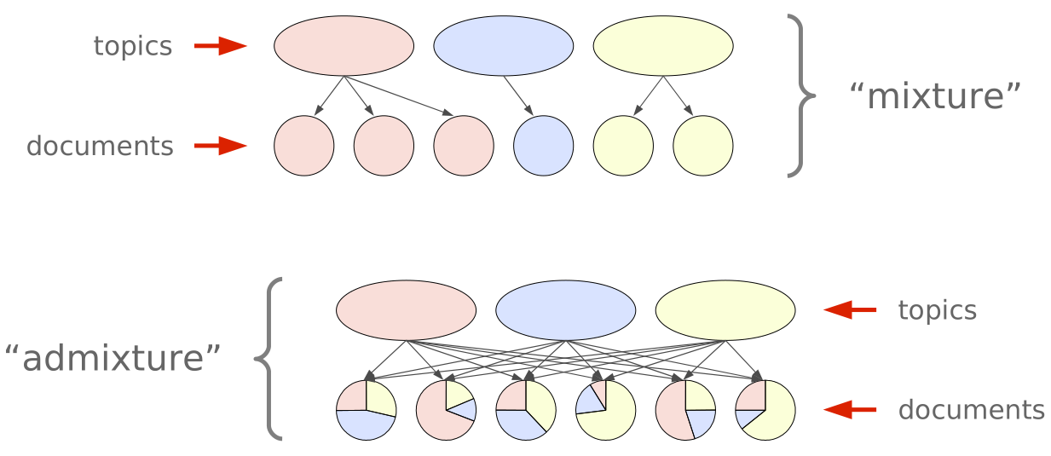
Latent Dirichlet Allocation
LDA further enriches Model 2 (mixture of topics) by allowing multiple topics in a single document, which is an admixture or mixed membership model model.

Slide 18
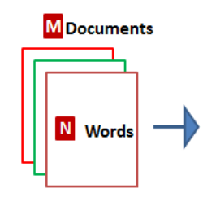

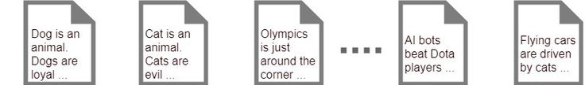
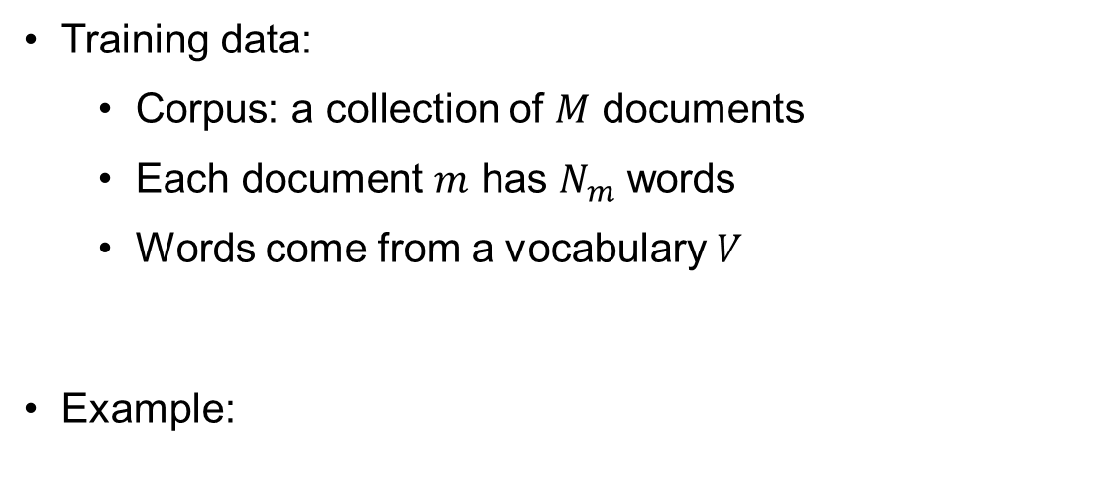
Latent Dirichlet Allocation – Elements
Training data:
Corpus: a collection of $M$ documents
Each document $m$ has $N_{m}$ words
Words come from a vocabulary $V$
Example:

Slide 19
Latent Dirichlet Allocation – Elements
The LDA model:
Document-topic distribution
Dirichlet
Topic-word distribution
Word-topic assignment
Dirichlet
Observed word

Slide 20
LDA – Generative Process
The best way to understand LDA is to see how it generate texts (as a generative model):

Slide 21
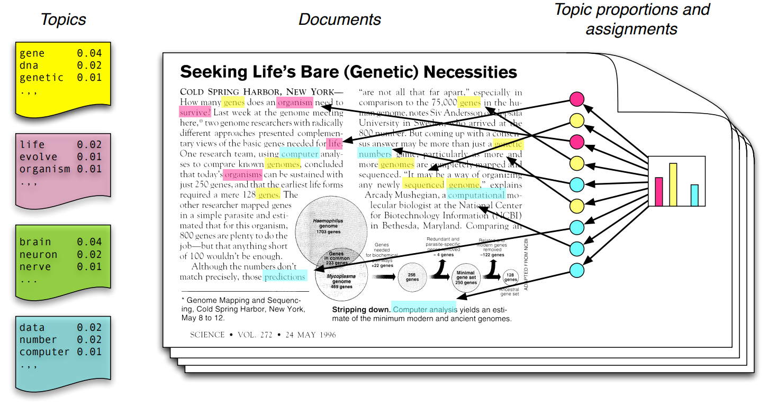
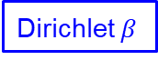
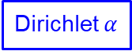
LDA – Generative Process
Dirichlet $α$
Dirichlet $β$
Bag-of-words with high probabilities summarize a topic.

Slide 22
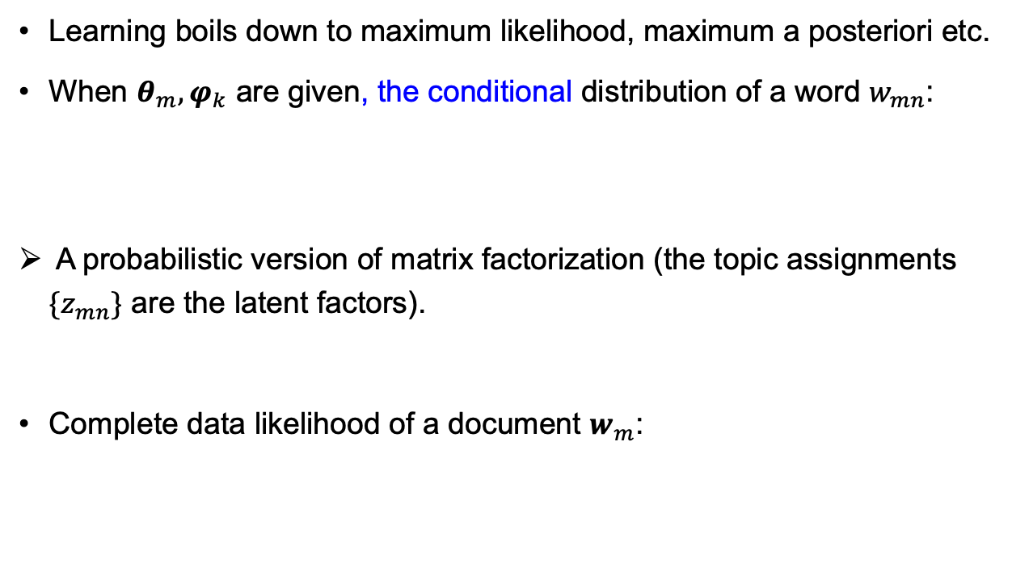
LDA – Learning
Learning boils down to maximum likelihood, maximum a posteriori etc.
When $θ_{m},φ_{k}$ are given, the conditional distribution of a word $w_{mn}$:
A probabilistic version of matrix factorization (the topic assignments $\{z_{mn}\}$ are the latent factors).
Complete data likelihood of a document $w_{m}$:
Words
Documents
Topics
Sum over

Slide 23
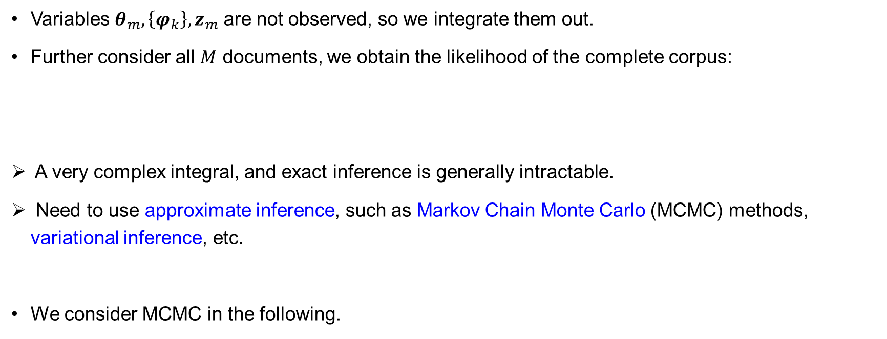
LDA – Learning
Variables $θ_{m},\left\{φ_{k}\right\},z_{m}$ are not observed, so we integrate them out.
Further consider all $M$ documents, we obtain the likelihood of the complete corpus:
A very complex integral, and exact inference is generally intractable.
Need to use approximate inference, such as Markov Chain Monte Carlo (MCMC) methods, variational inference, etc.
We consider MCMC in the following.
Notes:
One reason why the course “statistical computation” is important.

Slide 24
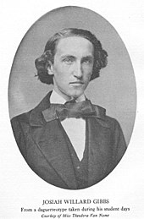
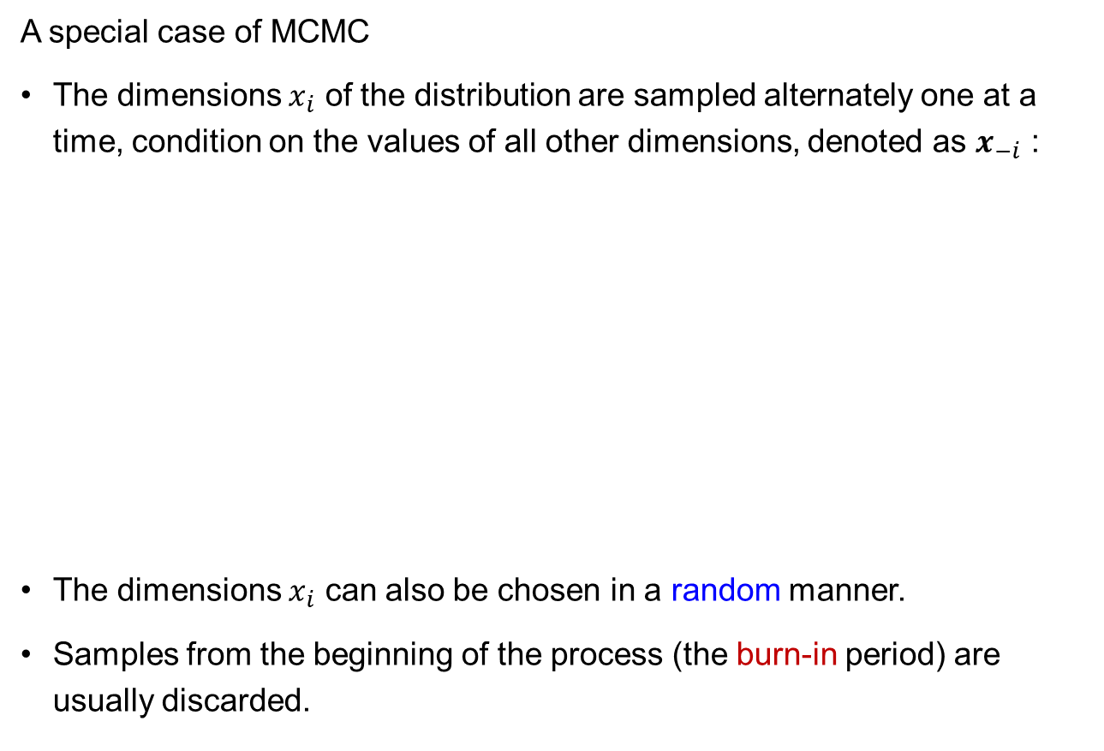
Gibbs Sampling
A special case of MCMC
The dimensions $x_{i}$ of the distribution are sampled alternately one at a time, condition on the values of all other dimensions, denoted as $x_{−i}$ :
The dimensions $x_{i}$ can also be chosen in a random manner.
Samples from the beginning of the process (the burn-in period) are usually discarded.
Josiah Willard Gibbs
1839–1903

Slide 25
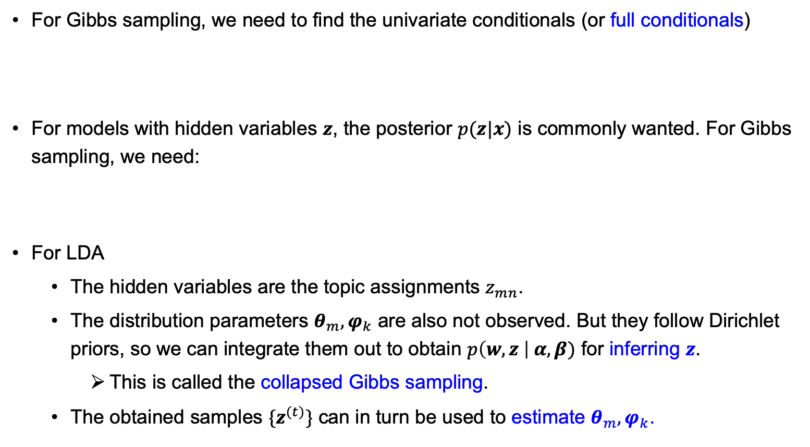
Gibbs Sampling
For Gibbs sampling, we need to find the univariate conditionals (or full conditionals)
For models with hidden variables $z$, the posterior $p(z|x)$ is commonly wanted. For Gibbs sampling, we need:
For LDA
The hidden variables are the topic assignments $z_{mn}$.
The distribution parameters $θ_{m},φ_{k}$ are also not observed. But they follow Dirichlet priors, so we can integrate them out to obtain $p\left(w,z \right| α,β)$ for inferring $z$.
This is called the collapsed Gibbs sampling.
The obtained samples $\{z^{(t)}\}$ can in turn be used to estimate $θ_{m},φ_{k}$.

Slide 26
Collapsed Gibbs Sampling for LDA (1)
For convenience, we introduce the notations:
Firstly, we notice
where
Multinomial
Dirichlet

Slide 27
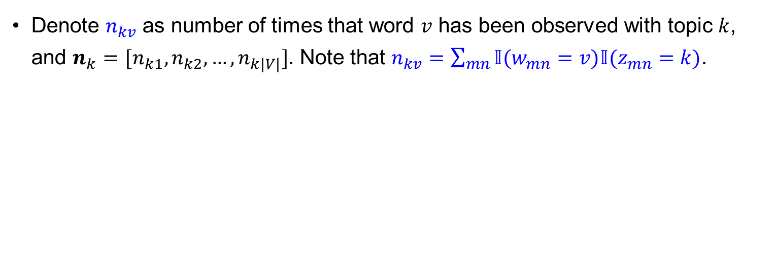
Collapsed Gibbs Sampling for LDA (2)
Multinomial
Dirichlet
Denote $n_{kv}$ as number of times that word $v$ has been observed with topic $k$, and $n_{k}=[n_{k1},n_{k2},…,n_{k|V|}]$. Note that $n_{kv}=\sum_{mn}{𝕀(w_{mn}=v)𝕀(z_{mn}=k)}$.

Slide 28
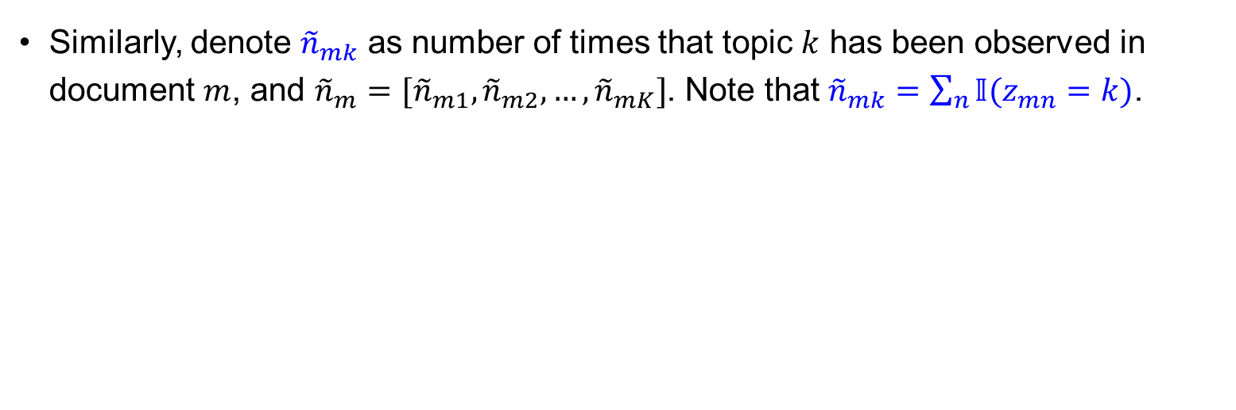
Collapsed Gibbs Sampling for LDA (3)
Multinomial
Dirichlet
Similarly, denote ${\tilde{n}}_{mk}$ as number of times that topic $k$ has been observed in document $m$, and ${\tilde{n}}_{m}=[{\tilde{n}}_{m1},{\tilde{n}}_{m2},…,{\tilde{n}}_{mK}]$. Note that ${\tilde{n}}_{mk}=\sum_{n}{𝕀(z_{mn}=k)}$.

Slide 29
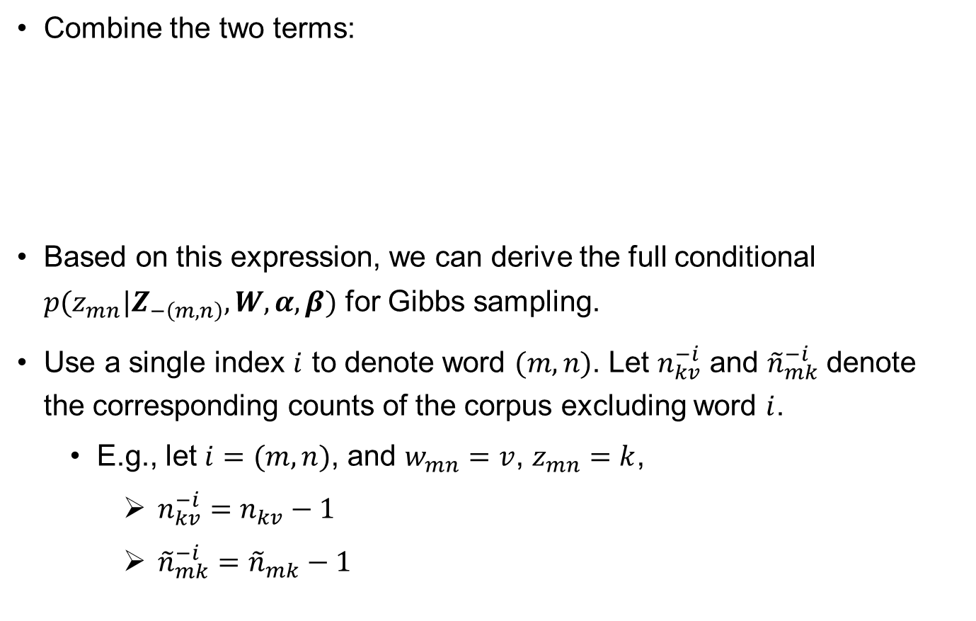
Collapsed Gibbs Sampling for LDA (4)
Combine the two terms:
Based on this expression, we can derive the full conditional $p(z_{mn}|Z_{−\left(m,n\right)},W,α,β)$ for Gibbs sampling.
Use a single index $i$ to denote word $(m,n)$. Let $n_{kv}^{−i}$ and ${\tilde{n}}_{mk}^{−i}$ denote the corresponding counts of the corpus excluding word $i$.
E.g., let $i=(m,n)$, and $w_{mn}=v$, $z_{mn}=k$,
$n_{kv}^{−i}=n_{kv}−1$
${\tilde{n}}_{mk}^{−i}={\tilde{n}}_{mk}−1$

Slide 30
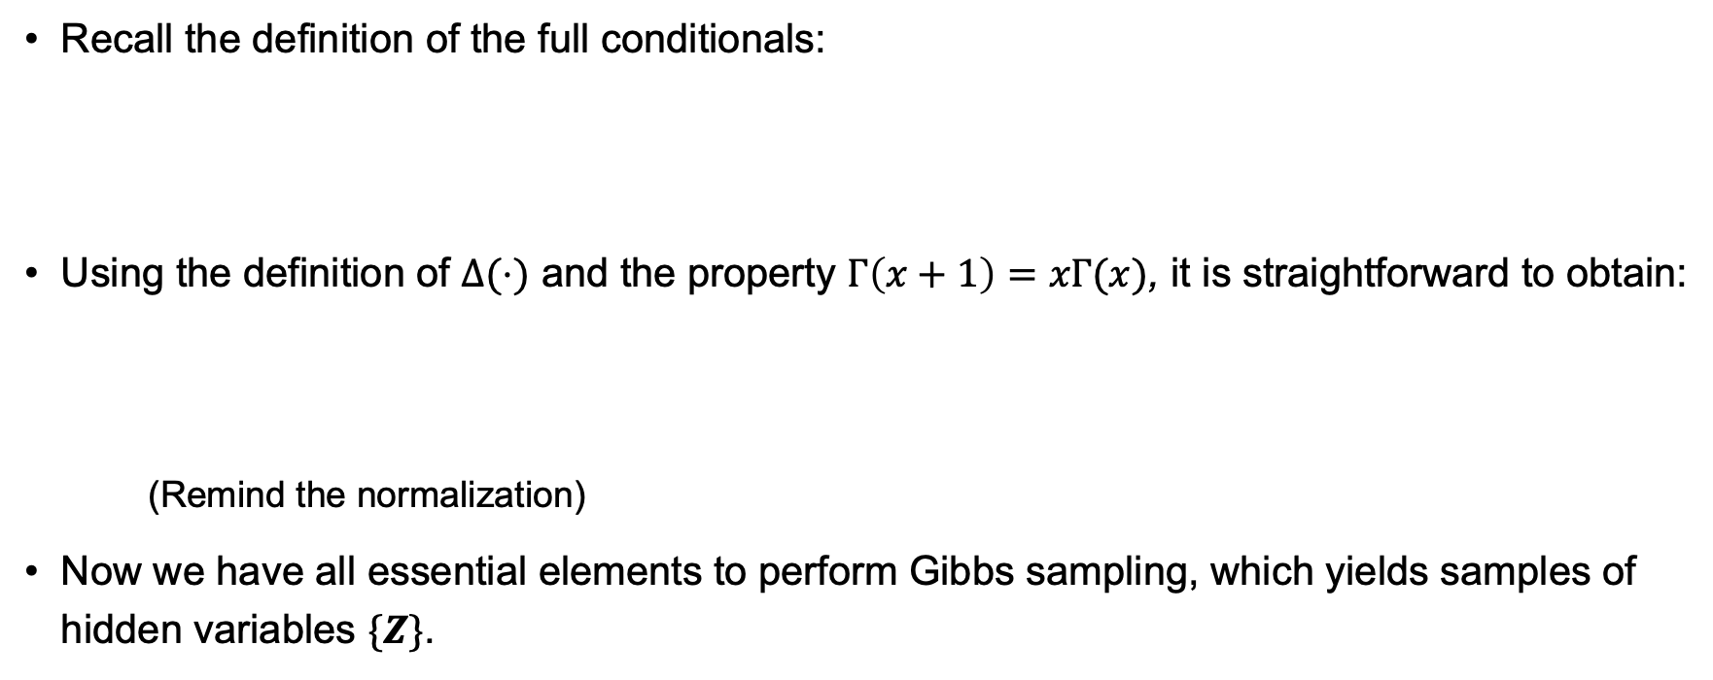
Collapsed Gibbs Sampling for LDA (5)
Recall the definition of the full conditionals:
Using the definition of $Δ(⋅)$ and the property $Γ\left(x+1\right)=xΓ(x)$, it is straightforward to obtain:
(Remind the normalization)
Now we have all essential elements to perform Gibbs sampling, which yields samples of hidden variables $\{Z\}$.
①
Notes:
Interpretation of the full conditional:
1st term: how often that word v is generated by the topic k (both data and prior)
2nd term: how often that topic k is used in that document m (both data and prior)

Slide 31
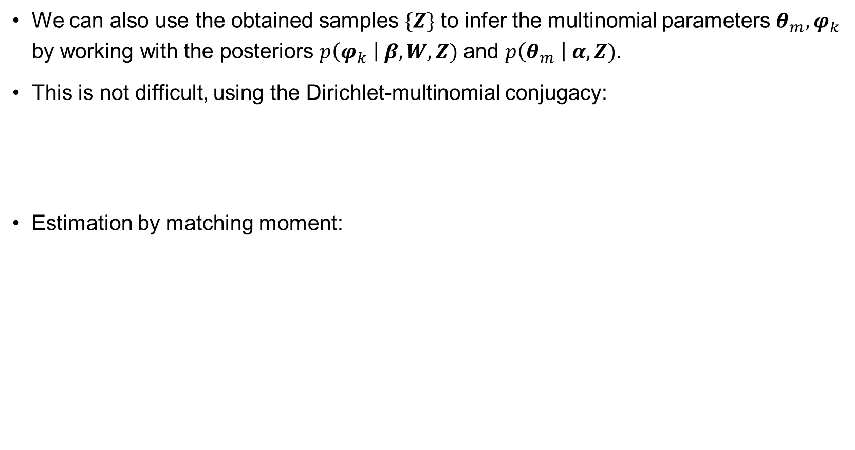
Collapsed Gibbs Sampling for LDA (6)
We can also use the obtained samples $\{Z\}$ to infer the multinomial parameters $θ_{m},φ_{k}$ by working with the posteriors $p\left(φ_{k} \right| β, W, Z)$ and $p\left(θ_{m} \right| α, Z)$.
This is not difficult, using the Dirichlet-multinomial conjugacy:
Estimation by matching moment:
②
③

Slide 32
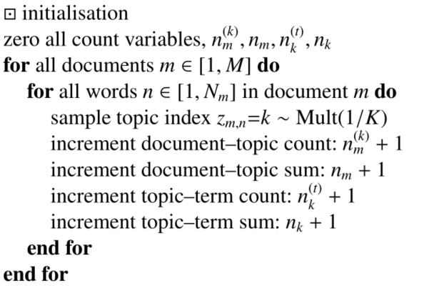

Collapsed Gibbs Sampling for LDA (7)
①
[“Parameter estimation for text analysis”, Technical Note by Gregor Heinrich]
(The notations are slightly different from ours.)
②
③
Notes:
The derivation is complex, but implementation is easy.

Slide 33

Practicality
The Dirichlet parameters $α,β$ are input parameters to the algorithm. They influence the behavior of LDA. Typically, symmetric Dirichlet priors are used.
Their values may be learnt through from data.
Some heuristic values have been suggested.
Similar issues apply to the number of topics $K$.
Again, heuristics or learnt from data (e.g., by maximizing the evidence).
Non-parametric Bayesian methods.
Evaluation of LDA (unsupervised learning) can be tricky and “subjective”.
Perplexity: how well the model predicts some unseen text (in terms of occurrence probability).
Gibbs sampling is simple to implement, but can be slow.
Variational EM algorithm is a faster alternative.

Slide 34

LDA – Applications
[David M. Blei, “Introduction to Probabilistic Topic Models”, 2011]

Slide 35

LDA – Applications
[David M. Blei, “Introduction to Probabilistic Topic Models”, 2011]

Slide 36

LDA – Applications
Three topics in 100 years of “Vogue” fashion magazine.
http://dh.library.yale.edu/projects/vogue/topics/

Slide 37


LDA – Extensions
Correlated and hierarchical topic models learn dependencies between topics.
[David M. Blei and John D. Laffert, “Correlated Topic Models”, 2005]

Slide 38


LDA – Extensions
Dynamical evolution of topics over time
[David M. Blei and John D. Laffert, “Dynamic Topic Models”, 2006]
Notes:
Peak of ca2 ?

Slide 39
Implementation and Summary
Implementation
Matlab: https://www.mathworks.com/help/textanalytics/ref/ldamodel.html
sklearn or gensim package in Python:
https://scikit-learn.org/stable/modules/generated/sklearn.decomposition.LatentDirichletAllocation.html
https://github.com/rare-technologies/gensim (doc: https://radimrehurek.com/gensim/)
Also available in many other languages.
Summary of LDA
A topic model based on bag-of-words to summarize topics
Hierarchical Bayesian latent factor model (extending matrix factorization)
Enjoys simplifications due to properties of Dirichlet
Many applications, and serves as a building block for other models

